Slide 1
TALKING JESUS
UK research on evangelism in 2018
Изследвания за евангелизирането през 2018 г.

Slide 2
Colossians 4.2-4 Колосяни
Devote yourselves to prayer with an alert mind and a thankful heart. Pray for us, too, that God will give us many opportunities to speak about His mysterious plan concerning Christ. That is why I am here in chains. Pray that I will proclaim this message as clearly as I should.
Постоянствайте в молитвата с бодър дух и благодарност, като се молите и за нас – Бог да ни отвори врата за словото, за да разгласим Христовата тайна, заради която именно съм в окови, за да я открия така, както трябва да говоря.

Slide 3
Colossians 4.2-4 Колосяни
Devote yourselves to prayer with an alert mind and a thankful heart. Pray for us, too, that God will give us many opportunities to speak about His mysterious plan concerning Christ. That is why I am here in chains. Pray that I will proclaim this message as clearly as I should.
Постоянствайте в молитвата с бодър дух и благодарност, като се молите и за нас – Бог да ни отвори врата за словото, за да разгласим Христовата тайна, заради която именно съм в окови, за да я открия така, както трябва да говоря.

Slide 4
Colossians 4.2-4 Колосяни
Devote yourselves to prayer with an alert mind and a thankful heart. Pray for us, too, that God will give us many opportunities to speak about His mysterious plan concerning Christ. That is why I am here in chains. Pray that I will proclaim this message as clearly as I should.
Постоянствайте в молитвата с бодър дух и благодарност, като се молите и за нас – Бог да ни отвори врата за словото, за да разгласим Христовата тайна, заради която именно съм в окови, за да я открия така, както трябва да говоря.

Slide 5
TALKING JESUS
UK research on evangelism in 2018
Изследвания за евангелизирането през 2018 г.

Slide 6
Where ARE we at?
Talking Jesus #1

Slide 7
What types of people?
“Practising Christian”
Prays at least weekly
Reads Bible at least weekly
Attends church at least monthly
“Christian”
Describes themselves as Christian,
but not like a “Practising Christian”
“non-Christian”
Has a religious faith other than Christian,
or says they don’t have one

Slide 8
How many of each kind are there?

Slide 9
How many non-Christians know practising Christians (like us)?

Slide 10
Where do they know us from?

Slide 11
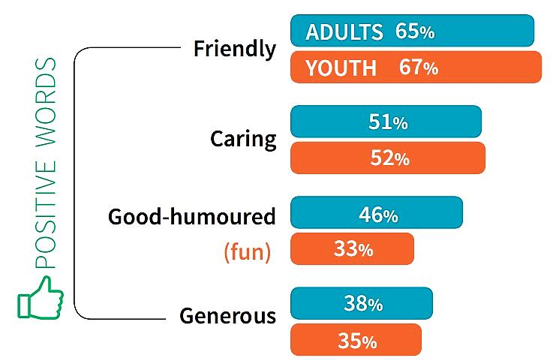
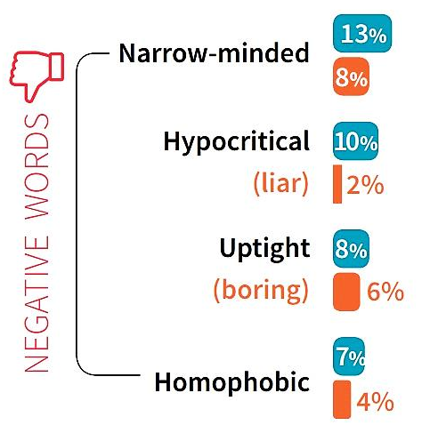
What do non-Christians think of us?

Slide 12
Open doors for talking Jesus
They know us and they like us!

Slide 13
Table talk – 5 mins
If you would say you’re a “practising Christian”…
Who are the non-Christians you know best?
Is what non-Christians think of you surprising?
If you wouldn’t say you are a “practising Christian”…
How many practising Christians do you know?
What has been your experience of them?

Slide 14
What about Jesus?
Talking Jesus #2

Slide 15
Is Jesus a real historical person?

Slide 16
Who do you think Jesus is?

Slide 17
Do you believe Jesus rose from the dead?
Adults
Youth (11-18)

Slide 18
Open doors for talking Jesus
They know us and they like us!
People admire Jesus and wonder if really He did rise from the dead!

Slide 19
Table talk – 5 mins
If you would say you’re a “practising Christian”…
How could you help people see that Jesus is a real historical person?
What impact does Jesus being alive have on your life today?
If you wouldn’t say you’re a practising Christian…
Why don’t people today think Jesus was a real historical person?
Do you think it matters if Jesus really did rise from the dead?

Slide 20
TALKING JESUS
UK research on evangelism in 2018
Изследвания за евангелизирането през 2018 г.

Slide 21
Colossians 4.5-6 Колосяни
Live wisely among those who are not believers, and make the most of every opportunity. Let your conversation be gracious and attractive so that you will have the right response for everyone.
С външните се отнасяйте мъдро, като скъпите времето. Словото ви да бъде винаги благо, разумно и да знаете как трябва да отговаряте на всеки.

Slide 22
Colossians 4.5-6 Колосяни
Live wisely among those who are not believers, and make the most of every opportunity. Let your conversation be gracious and attractive* so that you will have the right response for everyone.
С външните се отнасяйте мъдро, като скъпите времето. Словото ви да бъде винаги благо, разумно* и да знаете как трябва да отговаряте на всеки.
* = “seasoned with salt”, подправен със сол

Slide 23
What are we saying?
Talking Jesus #3

Slide 24
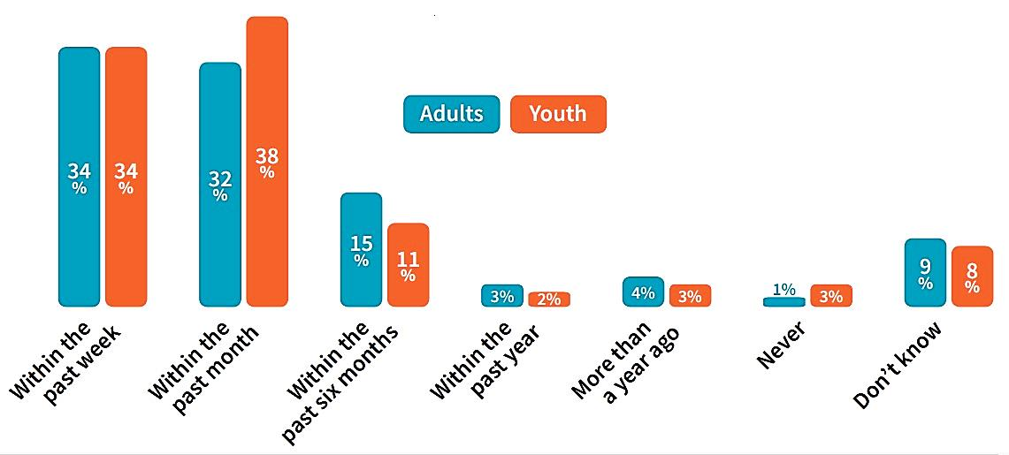
When did you last talk to a non-Christian about Jesus?

Slide 25
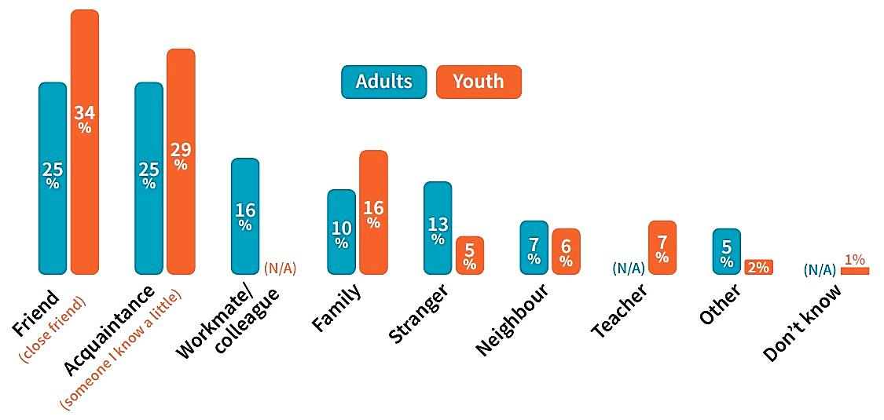
Who was this non-Christian you talked to?

Slide 26
Has the practising Christian you know ever talked to you about Jesus?
Adults
Youth (11-18)

Slide 27
After a practising Christian talks to them about Jesus, a non-Christian…

Slide 28
Open doors for talking Jesus
They know us and they like us!
People admire Jesus and wonder if really He did rise from the dead!
When we talk to people we know about Jesus, 1 in 5 want to know more – even if it’s the first time we’ve tried!

Slide 29
Table talk – 5 mins
If you would say you’re a “practising Christian”…
Write down the names of 5 people you’d like to talk about Jesus with
How many of these have you never spoken to about Jesus before?
If you wouldn’t say you’re a practising Christian…
When did one last talk to you about Jesus?
How did you feel after, and do you think they realised?

Slide 30
TALKING JESUS
UK research on evangelism in 2018
Изследвания за евангелизирането през 2018 г.

